Slide 1
Implementation and Analysis of Data Mining Algorithms in R
Linear Regression, Naïve Bayes, KNN, and Decision Trees (ID3, C4.5) Mohansai Veeravalli
Hiray college

Slide 2
Agenda
Introduction to Linear Regression
Implementation of Naïve Bayes
Classification with K-Nearest Neighbor
Decision Trees (ID3 and C4.5)
Summary and Key Takeaways

Slide 3
Linear Regression
Introduction to Linear Regression
Definition:
Linear regression is a method to predict a continuous value based on the relationship between input variables (also called independent variables) and the output variable (dependent variable).
Formula: Y=β0+β1X+ϵ
Example:
Predict house prices based on square footage.
Imagine you are trying to predict the price of a house based on its size. Larger houses typically cost more, so there is a relationship between size and price. Linear regression helps us find the best straight line that describes this relationship.

Slide 4
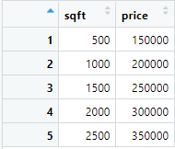
Example Data
Linear regression models the relationship as a straight line:
y=m*x+b

Slide 5

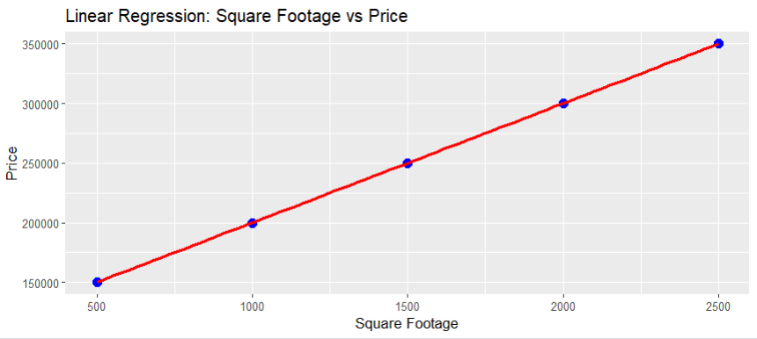
Implementation in R

Slide 6
Naïve Bayes
Introduction to Naïve Bayes
Definition: Probabilistic classifier based on Bayes' theorem.
Assumption: Features are independent.
Example: Classify fruits as "Apple" or "Orange" based on color and size.

Slide 7
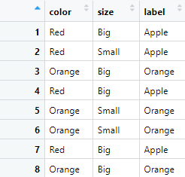
Example Data

Slide 8

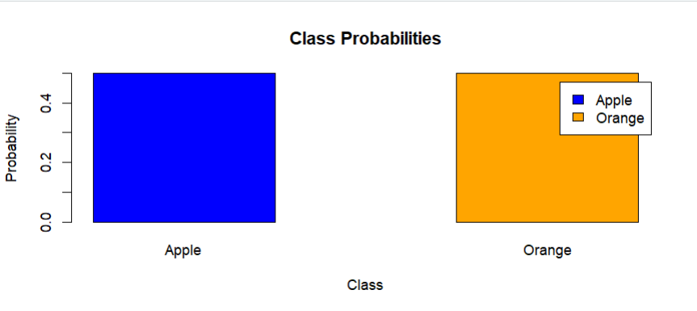
Implementation in R

Slide 9
K-Nearest Neighbor (KNN)
Introduction to KNN
Definition:
Classifies data by majority voting of nearest neighbors.
Key Parameter:
Value of kk (number of neighbors).
Example:
Classify flowers based on petal length and width.

Slide 10
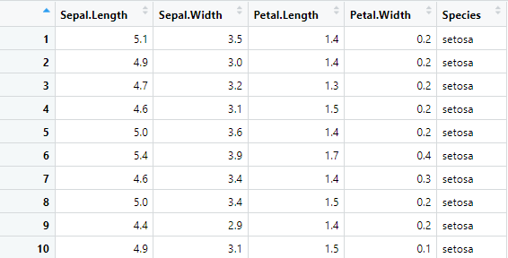
Example Data

Slide 11
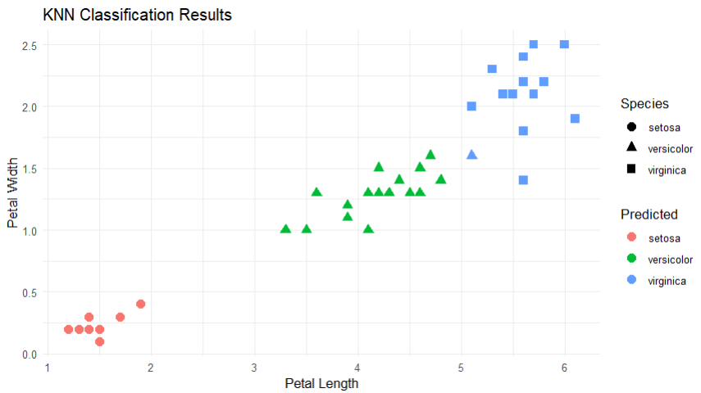
Implementation in R

Slide 12
Decision Trees (ID3 and C4.5)
Introduction to Decision Trees
Definition: Splits data based on feature values to classify data.
ID3: Uses information gain.
C4.5: Improvement of ID3, handles continuous features.

Slide 13
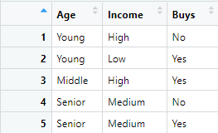
Example Data

Slide 14

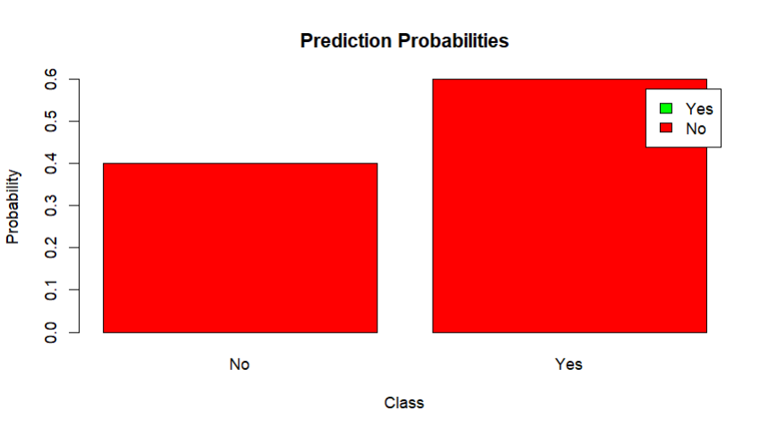
Implementation in R

